Slide 2
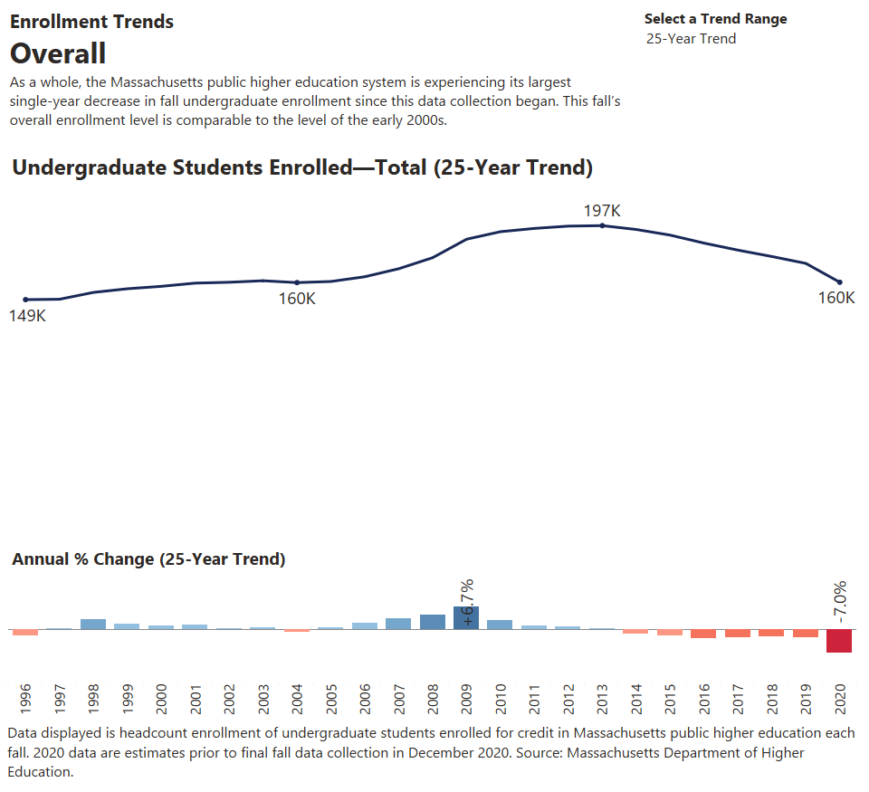

Slide 3
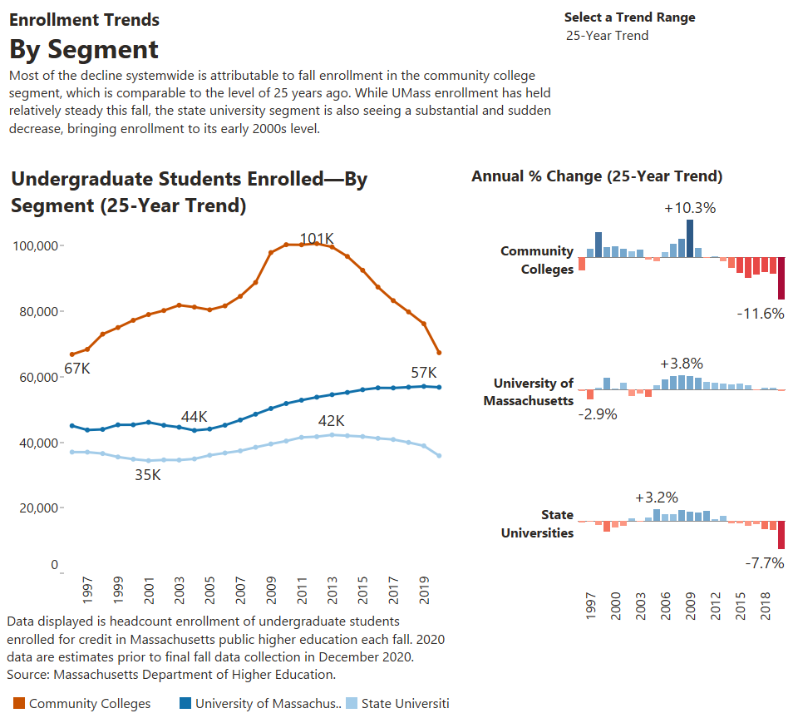

Slide 4
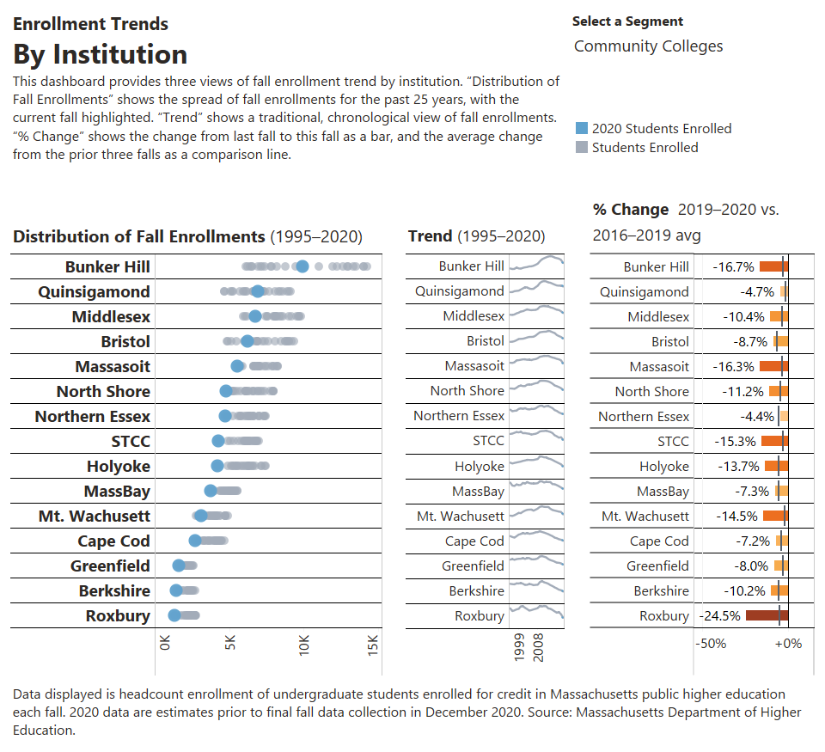

Slide 5
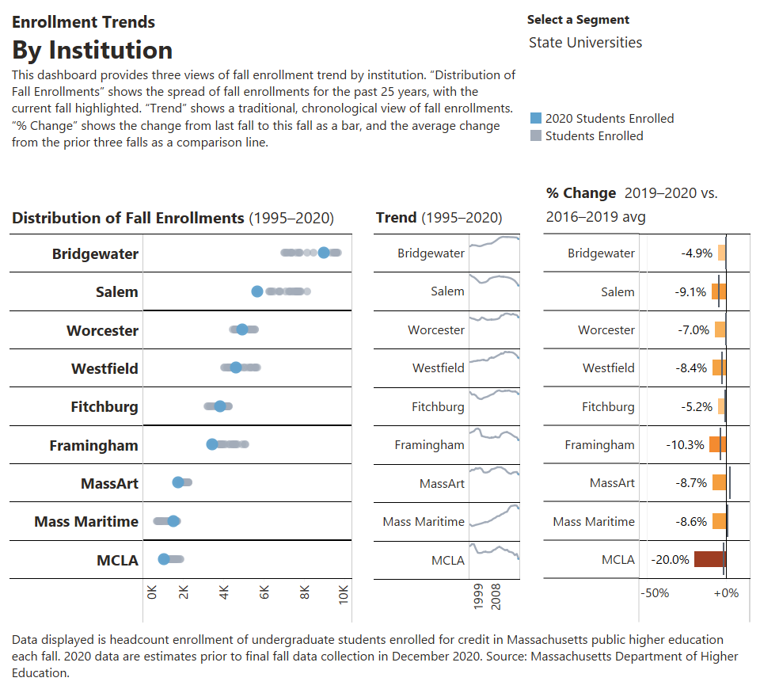

Slide 6
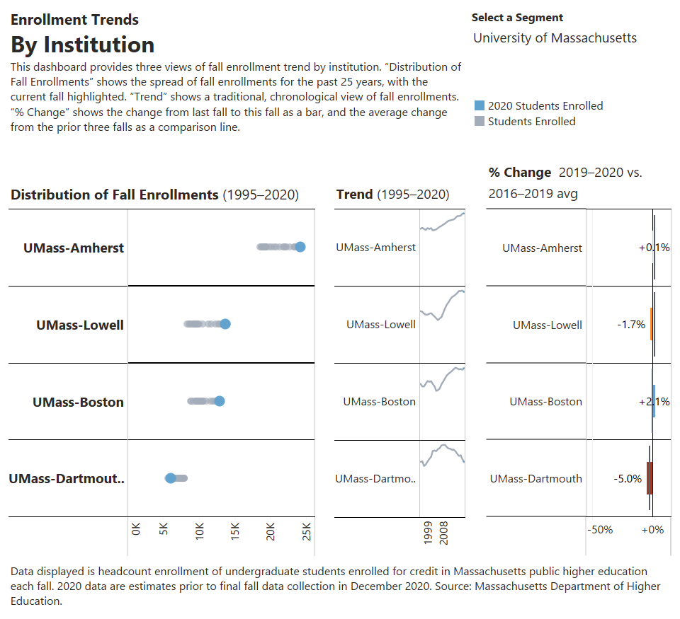

Slide 7
Visit DHE’s website at
www.mass.edu/datacenter
to explore this report interactively in Tableau!

